Slide 1
CSE 2500: Introduction to Discrete Systems
Lecture 10: Proofs with Rational Numbers
Kaleel Mahmood
Department of Computer Science and Engineering
University of Connecticut

Slide 2
Midterm Exam: Thursday October 13th 2022
Will cover everything up to and including the lecture Thursday October 6th.
We will have a review day on Tuesday October 11th to help you prepare for the exam.
Approximately 1 hour.
Closed notes, closed book. No computer. No calculator. Human brain only.

Slide 3
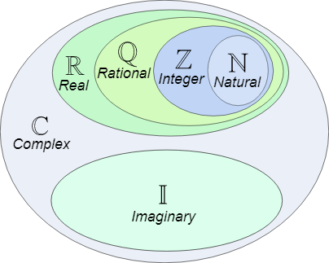
Previously we did proofs with integers, today we expand our proving capabilities to rational numbers….hooray!

Slide 4
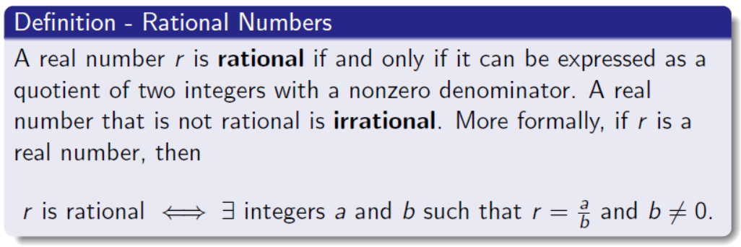
Rational Numbers

Slide 5
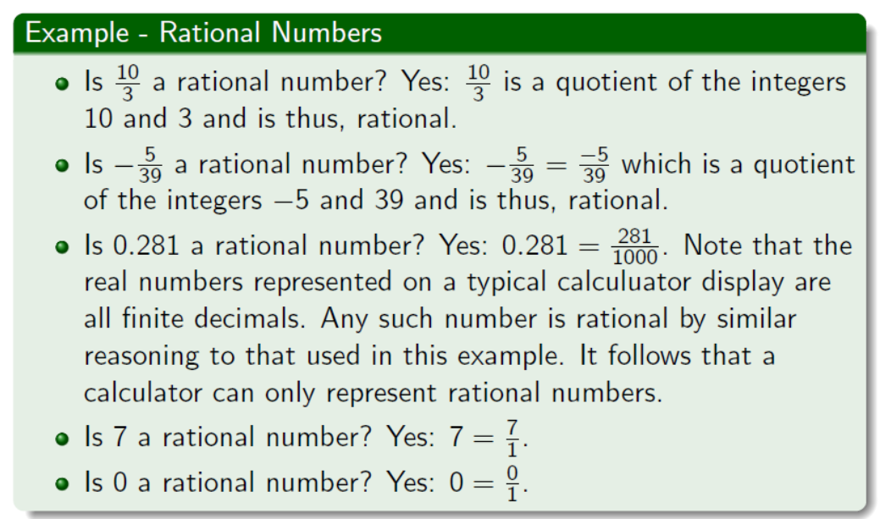
Rational Number Examples

Slide 6
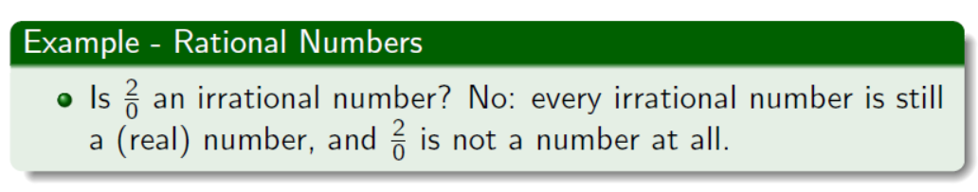
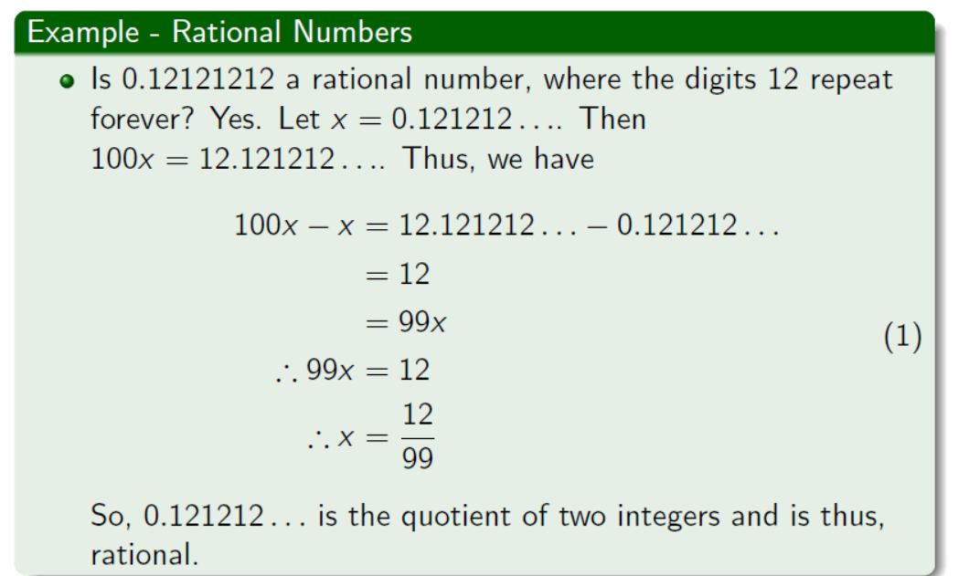

Slide 7
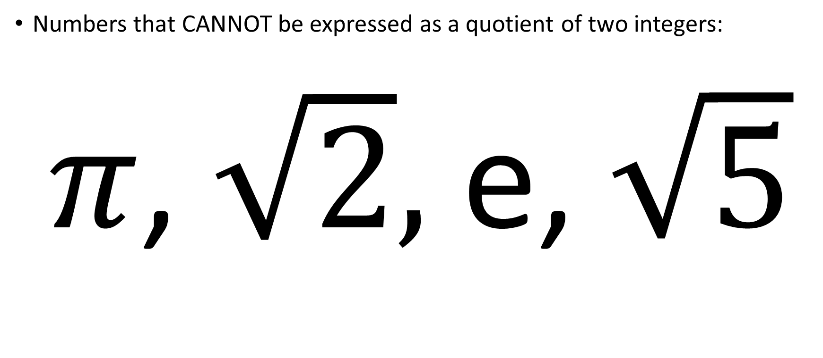
Examples of irrational numbers
Numbers that CANNOT be expressed as a quotient of two integers:
$π$, $\sqrt{2},$ e, $\sqrt{5}$

Slide 8
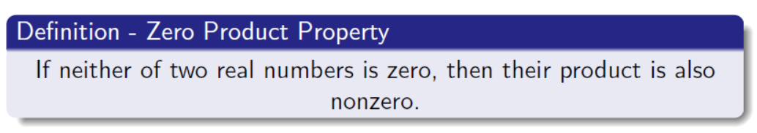
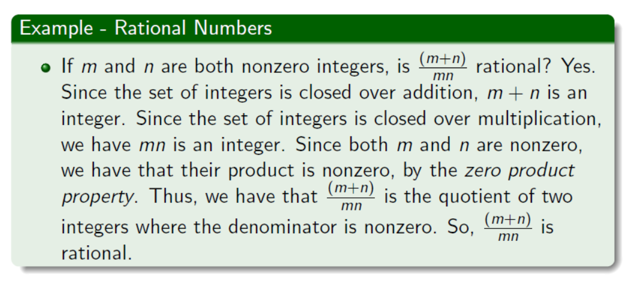
Zero Product Property

Slide 9
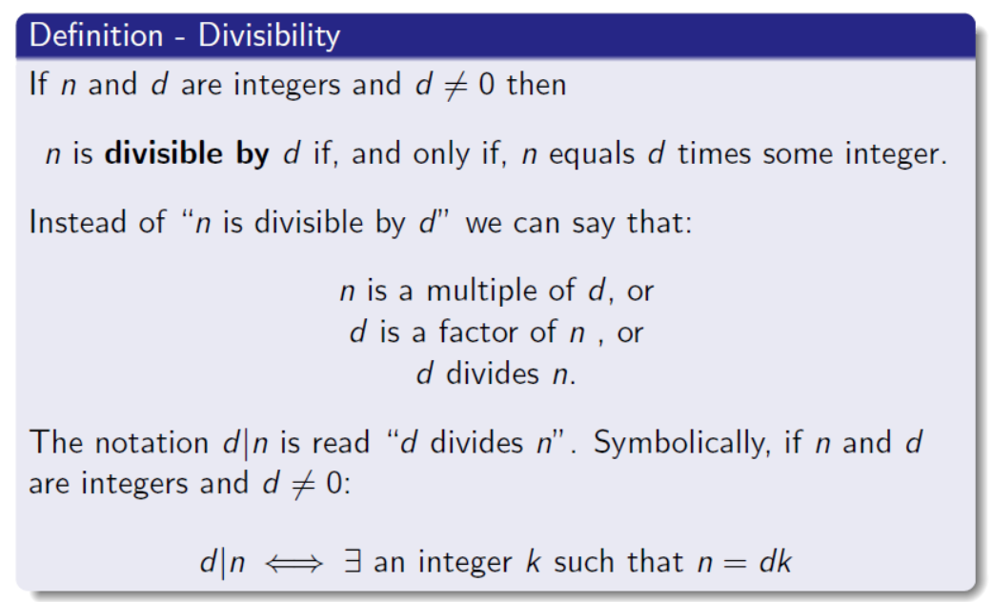
Divisibility

Slide 10
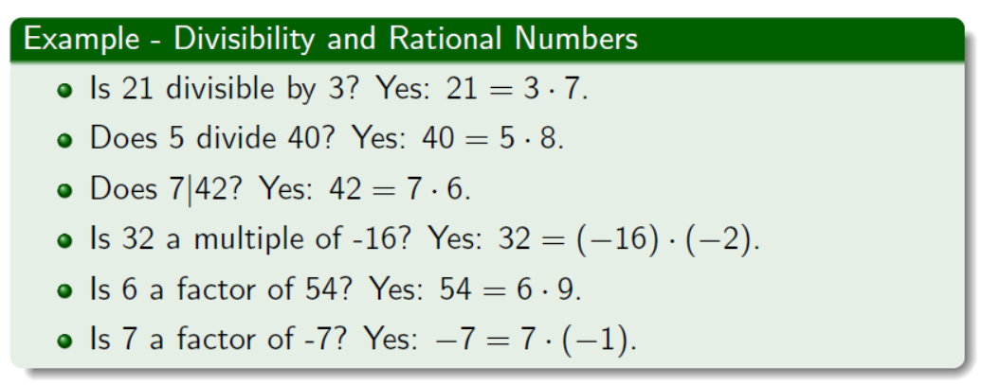
Examples of Divisibility

Slide 11
White Board Examples

Slide 12
We are learning proofs with rational numbers:
We are here…

Slide 13
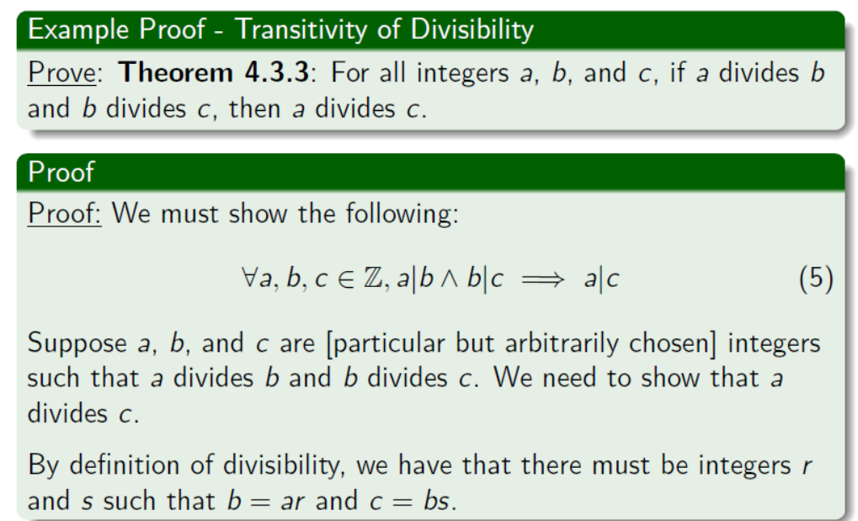

Slide 14
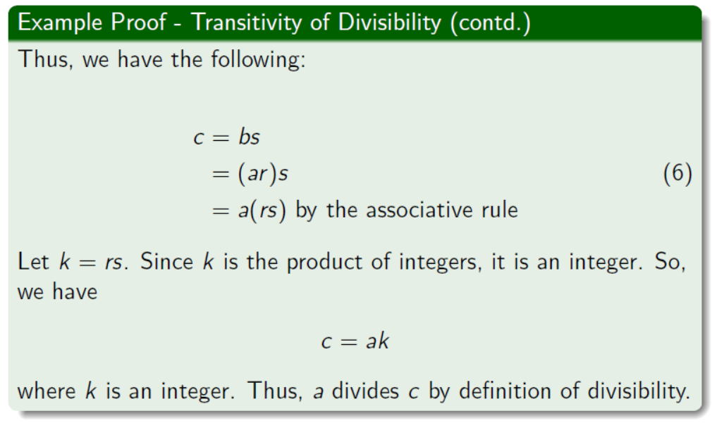

Slide 15
Three Whiteboard Examples

Slide 16
Figure Sources
https://www.mathsisfun.com/sets/images/number-sets.svg
Professor Joe Johnson’s Lecture Slides

